Slide 1
HD Wallets
Hierarchical deterministic wallets in cryptocurrencies

Slide 2
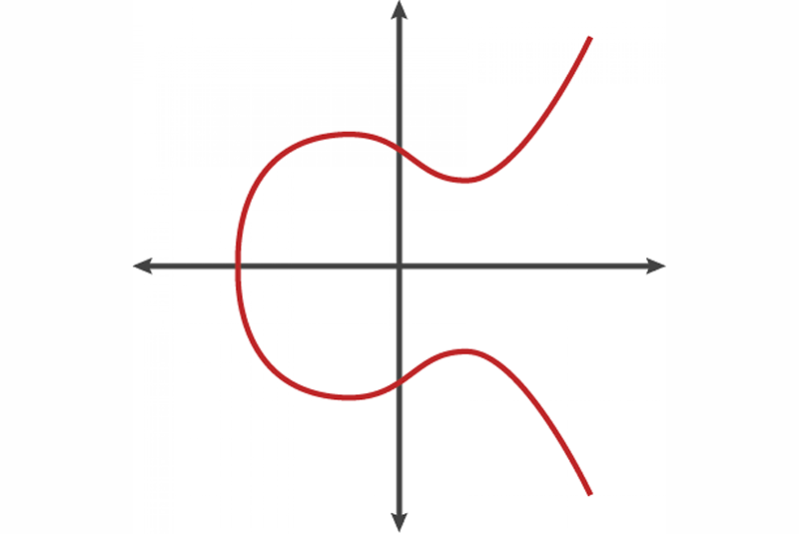

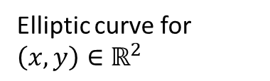

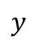
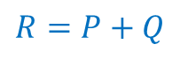
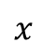


Recap: Elliptic curves – point addition
Point addition on an elliptic curve (“$+$“)
$$y$$
Elliptic curve for $\left(x,y\right){∈ℝ}^{2}$
$$P+Q=R$$
$$Q$$
$$−R$$
$$P$$
$$x$$
$$R=P+Q$$

Slide 3

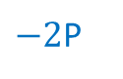



Recap: Elliptic curves – scalar multiplication
Scalar multiplication on an elliptic curve (“$⋅$“)
$$y$$
Elliptic curve for $\left(x,y\right){∈ℝ}^{2}$
$−2$P
$$P$$
$$P+P=2⋅P$$
Tangent @ $P$
$$x$$
$$2P$$

Slide 4
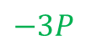
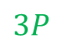

Recap: Elliptic curves – scalar multiplication
Scalar multiplication on an elliptic curve (“$⋅$“)
$$y$$
Elliptic curve for $\left(x,y\right){∈ℝ}^{2}$
$−2$P
$$P$$
$$P+P=2⋅P$$
$$3⋅P=2⋅P+P$$
…
$$3P$$
$$x$$
$$−3P$$
$$2P$$

Slide 5




Recap: Elliptic curves – point at infinity
Point doubling of two vertical points yields point at infinity
$$𝒪$$
$$y$$
Elliptic curve for $\left(x,y\right){∈ℝ}^{2}$
$P+Q=𝒪$ (point at infinity)
$$Q$$
$$x$$
$$P$$

Slide 6



Recap: Elliptic curves over cyclic groups
Elliptic curves for cryptography are defined over cyclic groups $ℤ_{p}^{∗}$, not $ℝ$
The elliptic curve is therefore defined as:
$y^{2}≡x^{3}+ax+b \left(mod p\right),p$ is prime
The blue dots resemble the elliptic curve now constrained between 0 and p
The yellow line resembles the point addition of points A and B:
$$A+B=C$$

Slide 7


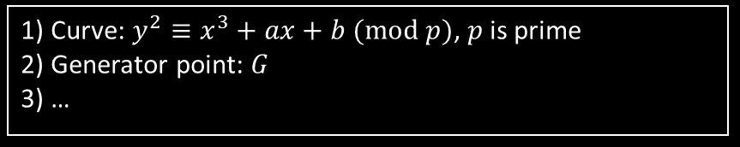
Recap: ECDSA – key creation
Alice wants to create a digital identity adhering to some public domain parameters for ECDSA
Public domain parameters
1) Curve: $y^{2}≡x^{3}+ax+b (mod p)$, $p$ is prime
2) Generator point: $G$
3) …
ALICE
Picks a “random“, secret integer as her private key: $d_{A}$, $1≤d_{A}≤n−1$
Calculates the public key as point $Q_{A}=d_{A}⋅G$ (In Bitcoin the public key is only the x coordinate of $Q_{A}$ plus a marker byte denoting $±y$)

Slide 8
Why use multiple Bitcoin addresses?
It is not recommended to use a single Bitcoin address for more than one transaction
Privacy issues (traceability etc.)
Security issues (if the one private key is uncovered, all funds are lost)
Therefore, one should use a separate public / private key pair for every sending as well as receiving transaction

public

private

Slide 9
Randomized vs. HD wallets
Randomized
HD






Seed
Master key pair


…










…
…






A large number of random public / private key pairs needs to be stored
Only one seed needs to be stored (usually as a mnemonic) and key pairs are derived from it
Hierarchical deterministic (HD) wallets (BIP-32) efficiently solve the task of using a separate Bitcoin (or other cryptocurrency) address for every transaction

Slide 10
Seed creation I: entropy
Start with the entropy, a 128 bit random integer
Random integer generator
SHA-256
128 bits entropy
First 4 bits of SHA-256
128 bits entropy
“+“ (conc)
4 bits checksum
132 bits
…
11 bits
11 bits
11 bits
mnemonic 12
mnemonic 1
mnemonic 2

Slide 11
Seed creation II: mnemonics
Mnemonics map 11 bit integers to 2048 readable words (BIP-39)
Integer | Word
00000000000 | abandon
00000000001 | ability
… | …
00001100000 | army
… | …
11111111111 | zoo

Slide 12
Seed creation III: seed
The mnemonics are combined with a so-called salt that consists of the string “mnemonic“ and an optional passphrase
Mnemonic
e.g. “army van defense carry jealous true garbage claim echo media make crunch“
Salt “mnemonic“ + (optional) passphrase
PBKDF2 – password-based key derivation function
HMAC – hash-based message authenticaion code HMAC-SHA512(data, key)
data
key
2048 times HMAC-SHA512 hashing → supposed to be computationally intensive: against brute-force attacks
PBKDF2
512-bit seed

Slide 13
Master private / public extended key
The 512-bit seed is used for derivation of the private key and the so-called chain code
512-bit seed
“Bitcoin seed“
HMAC-SHA512
key
data
512-bit hash
Master keys
Left 256 bits
Right 256 bits

256-bits private key m
256-bits chain code c
Elliptic curve multiplication with generator point G:
M = m · G
Extended private key = {m, c}
Extended public key = {M, c}
Important for child key derivation!

264-bits public key M

Slide 14
Child key derivation
Child keys can be derived in different ways from the extended public or private keys
Normal child private key from extended private key
Normal child public key from extended public key
Child public key is derived from public key → creation of new keys w/o having to access private keys, e.g. on public servers
Hardened child from extended private key
Child cannot be derived from public key → security advantage

Slide 15
Normal child from private key
Child public key is derived from public key, index, chain code and private key
Public key M
“+“ (conc)
Index i
Chain code c
n - order of the elliptic curve
i – key index, 0 ≤ i ≤ 2147483647 for normal children
Private key m
HMAC-SHA512
key
data
512-bit hash
Left 256 bits
Right 256 bits
Is used for child-child key derivation!
Scalar addition, mod n
256-bits child chain code c‘(i)

256-bits child private key m‘(i)
Extended private key with index i = {m‘(i), c‘(i)}
Extended public key with index i = {M‘(i), c‘(i)}
M‘ = m‘ · G

256-bits child public key M‘(i)

Slide 16
Normal child from public key
Child public key is derived from private key, index and chain code
Public key M
“+“ (conc)
Index i
Chain code c
i – key index, 0 ≤ i ≤ 2147483647 for normal children
HMAC-SHA512
key
data
512-bit hash
Convert left 256 bits to point
Right 256 bits
Point addition “+“
256-bits child chain code c‘(i)

256-bits child public key M‘(i)
Extended public key with index i = {M‘(i), c‘(i)}

Slide 17
Security issues with non-hardened children
If child private key is leaked, …
Extended parent public key
Parent public key M
“+“ (conc)
Index i
Chain code c
n - order of the elliptic curve
i – key index, 0 ≤ i ≤ 2147483647 for normal children
Parent private key m
HMAC-SHA512
key
data
512-bit hash
Left 256 bits
Right 256 bits
Scalar addition, mod n
256-bits child chain code c‘(i)

256-bits child private key m‘(i)
If one child private key is leaked, parent private key can be reconstructed and all sibling keys are compromised
M‘ = m‘ · G

256-bits child public key M‘(i)

Slide 18
Hardened child from private key
Hardened child public key is derived from private key, index, chain code
Private key m
“+“ (conc)
Index i
Chain code c
n - order of the elliptic curve
i – key index, 2147483648 ≤ i ≤ 4294967295 for hardened children
HMAC-SHA512
key
data
512-bit hash
Left 256 bits
Right 256 bits
Scalar addition, mod n
256-bits child chain code c‘(i)

256-bits child private key m‘(i)
Extended private key with index i = {m‘(i), c‘(i)}
Extended public key with index i = {M‘(i), c‘(i)}
M‘ = m‘ · G

256-bits child public key M‘(i)

Slide 19
Serialization of extended keys
Extended public & private keys can be passed around in a serialized Base58-format containing all necessary info
Bytes | Field | Explanation
4 bytes | Version | Places “xprv” 0488ade4 or “xpub” 0488b21e at the start.
1 byte | Depth | How many derivations deep this extended key is from the master key.
4 bytes | Parent Fingerprint | The first 4 bytes of the hash160 of the parent’s public key. This helps to identify the parent later.
4 bytes | Child Number | The index number of this child from the parent.
32 bytes | Chain Code | The extra 32 byte secret. This prevents others from deriving child keys without it.
32 bytes | Key | The private or public key (prepend 0x00)
Examplary extended private key:
xprv9tuogRdb5YTgcL3P8Waj7REqDuQx4sXcodQaWTtEVFEp6yRKh1CjrWfXChnhgHeLDuXxo2auDZegMiVMGGxwxcrb2PmiGyCngLxvLeGsZRq
Examplary extended public key:
xpub67uA5wAUuv1ypp7rEY7jUZBZmwFSULFUArLBJrHr3amnymkUEYWzQJz13zLacZv33sSuxKVmerpZeFExapBNt8HpAqtTtWqDQRAgyqSKUHu

Slide 20
Tree structure
There are some conventions for the tree structure (BIPs-44,49,84) so wallet software knows where to look for certain things given the seed
Derivation paths ( ‘ stands for hardened children):
m / purpose' / coin_type' / account' / change / index
Tree level | Meaning
m | Master, always “ m “
purpose' | Always “ 44‘ “
coin_type' | Bitcoin: “ 0‘ “, Bitcoin-Testnet: “ 1‘ “, Litecoin: “ 2‘ “
account' | Different accounts for organizational purposes
change | Differentiation between receiving or change addresses
index | Incremental index for every transaction

Slide 21
Summary HD wallets
Hierarchical
Child keys are all derived from one seed/mnemonics (only thing that needs to backed up)
Organization in a tree, usually after certain conventions
Deterministic
Derivation follows fixed, predefined rules
Nice side-effect: child public keys can be derived from parent public keys w/o knowledge of the private keys

Slide 22
References
[1] Andreas M. Antonopoulos, Mastering Bitcoin: Programming the Open Blockchain, Ch. 5 https://github.com/bitcoinbook/bitcoinbook
[2] Greg Walker, https://learnmeabitcoin.com/technical

Slide 24
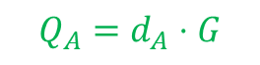



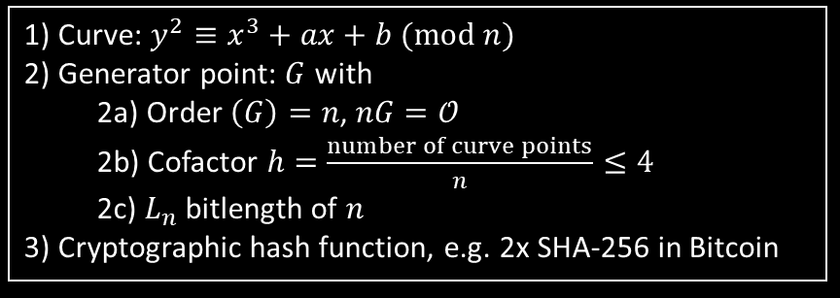
ECDSA – signing
Public domain parameters
Alice wants to prove to Bob that she is in possession of the private key $d_{A}$ that corresponds to the public key $Q_{A}$
1) Curve: $y^{2}≡x^{3}+ax+b (mod n)$
2) Generator point: $G$ with
2a) Order $\left(G\right)=n$, $nG=𝒪$ 2b) Cofactor $h=\frac{number of curve points}{n}≤4$
2c) $L_{n}$ bitlength of $n$
3) Cryptographic hash function, e.g. 2x SHA-256 in Bitcoin
ALICE
$$Q_{A}=d_{A}⋅G$$
Picks random integer $k$, $1≤k≤n−1$
Hashes a message $m$: $e=HASH(m)$ (In Bitcoin the message $m$ consists of parts of the transaction data)
Define $z$ as the $L_{n}$ leftmost bits of $e$
Calculate curve point $(x_{1},y_{1})=k⋅G$
Calculate $r=x_{1} mod n$ (must be $≠0$, otherwise repeat step 1)
Calculate $s=k^{−1}\left(z+r d_{A}\right) mod n$ (must be ≠0, otherwise repeat step 1)
Now $(r,s)$ and $(r,−s mod n)$ are valid signatures with respect to $Q_{A}$ (Bitcoin only accepts ‘high-s‘ values)

Slide 25






ECDSA – verification
Public domain parameters
Bob wants to verify that Alice‘s signature $(r,s)$ is valid with respect to the public key $Q_{A}$
1) Curve: $y^{2}≡x^{3}+ax+b (mod n)$
2) Generator point: $G$with
2a) Order $\left(G\right)=n$, $nG=𝒪$ 2b) Cofactor $h=\frac{number of curve points}{n}≤4$
2c) $L_{n}$ bitlength of $n$
3) Cryptographic hash function, e.g. 2x SHA-256 in Bitcoin
ALICE
BOB
$$(r,s)$$
$$m$$
Number of steps to check for correct format and basic math. properties of $(r,s)$ and $Q_{A}$
Hashes a message $m$: $e=HASH(m)$ (In Bitcoin the message $m$ consists of parts of the transaction data)
Define $z$ as the $L_{n}$ leftmost bits of $e$
Calculate $u_{1}=zs^{−1} mod n$
Calculate $u_{2}=rs^{−1} mod n$
Calculate curve point $\left(x_{1},y_{1}\right)=u_{1}⋅G+u_{2}⋅Q_{A}$
If $r≡x_{1} (mod n)$, $(r,s)$ is a valid signature with respect to $Q_{A}$

